Slide 1
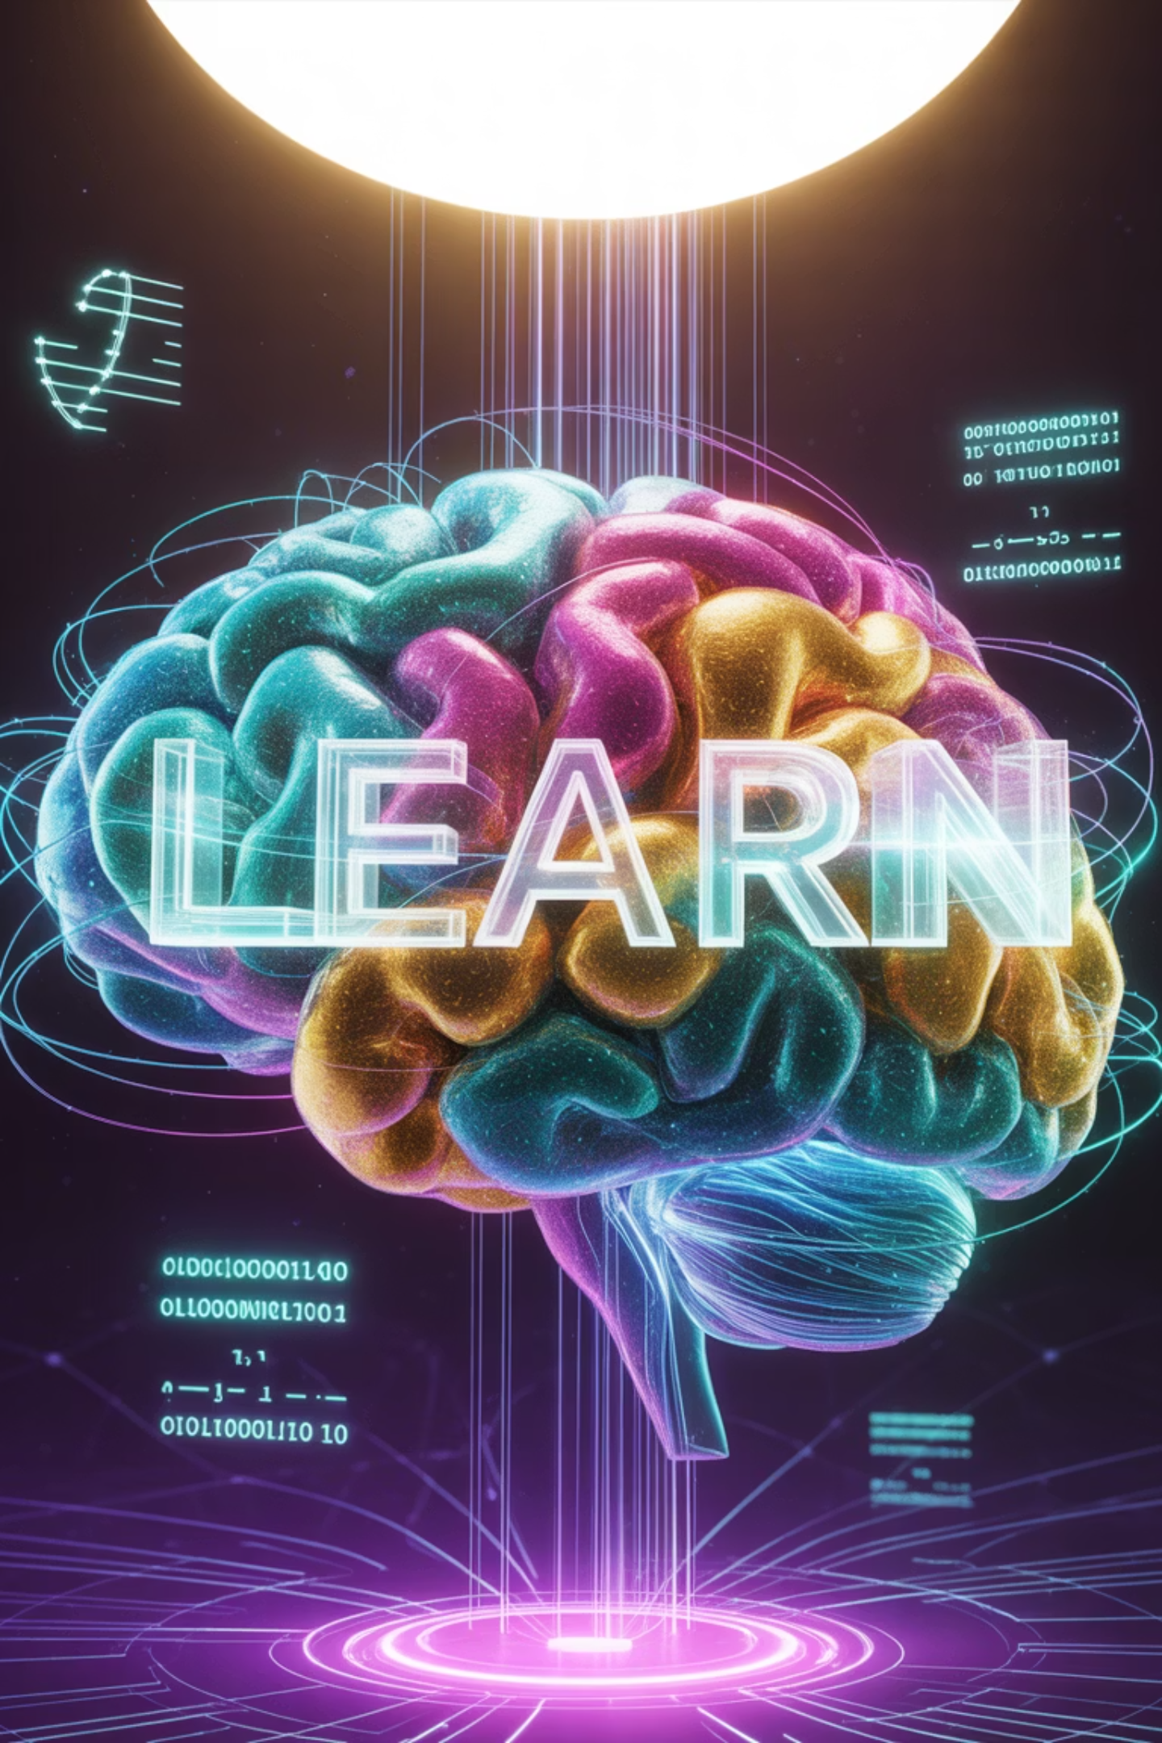
Deep Learning Module-2: Supervised Learning & CNNs
Welcome to Module 2 of our Deep Learning series, where we'll explore supervised learning and Convolutional Neural Networks (CNNs). This presentation is designed for graduate students and early-career ML engineers seeking practical, real-life examples of these powerful technologies that are transforming our world.
Throughout this module, we'll connect complex concepts to everyday analogies, making them more intuitive and accessible. Let's begin our journey into the fascinating world of deep learning!

Slide 2




What is Supervised Deep Learning?
Real-Life Analogy: Driving Lessons
Instructor provides examples: "When you see a red light, stop"
You practice with guidance: Repeated exposure to traffic situations
Eventually drive independently: Handle new traffic scenarios confidently
In Deep Learning:
Uses labeled data (input-output pairs) for training
Learns complex patterns from high-dimensional data
Eventually makes predictions on new, unseen data
Like learning to drive with an instructor, supervised deep learning follows a guided approach to mastery.
Everyday Examples:
Email spam detection: Learning from examples of spam vs legitimate emails
Photo tagging: Learning to recognize faces from tagged photos
Voice assistants: Learning to understand speech from audio-text pairs

Slide 3
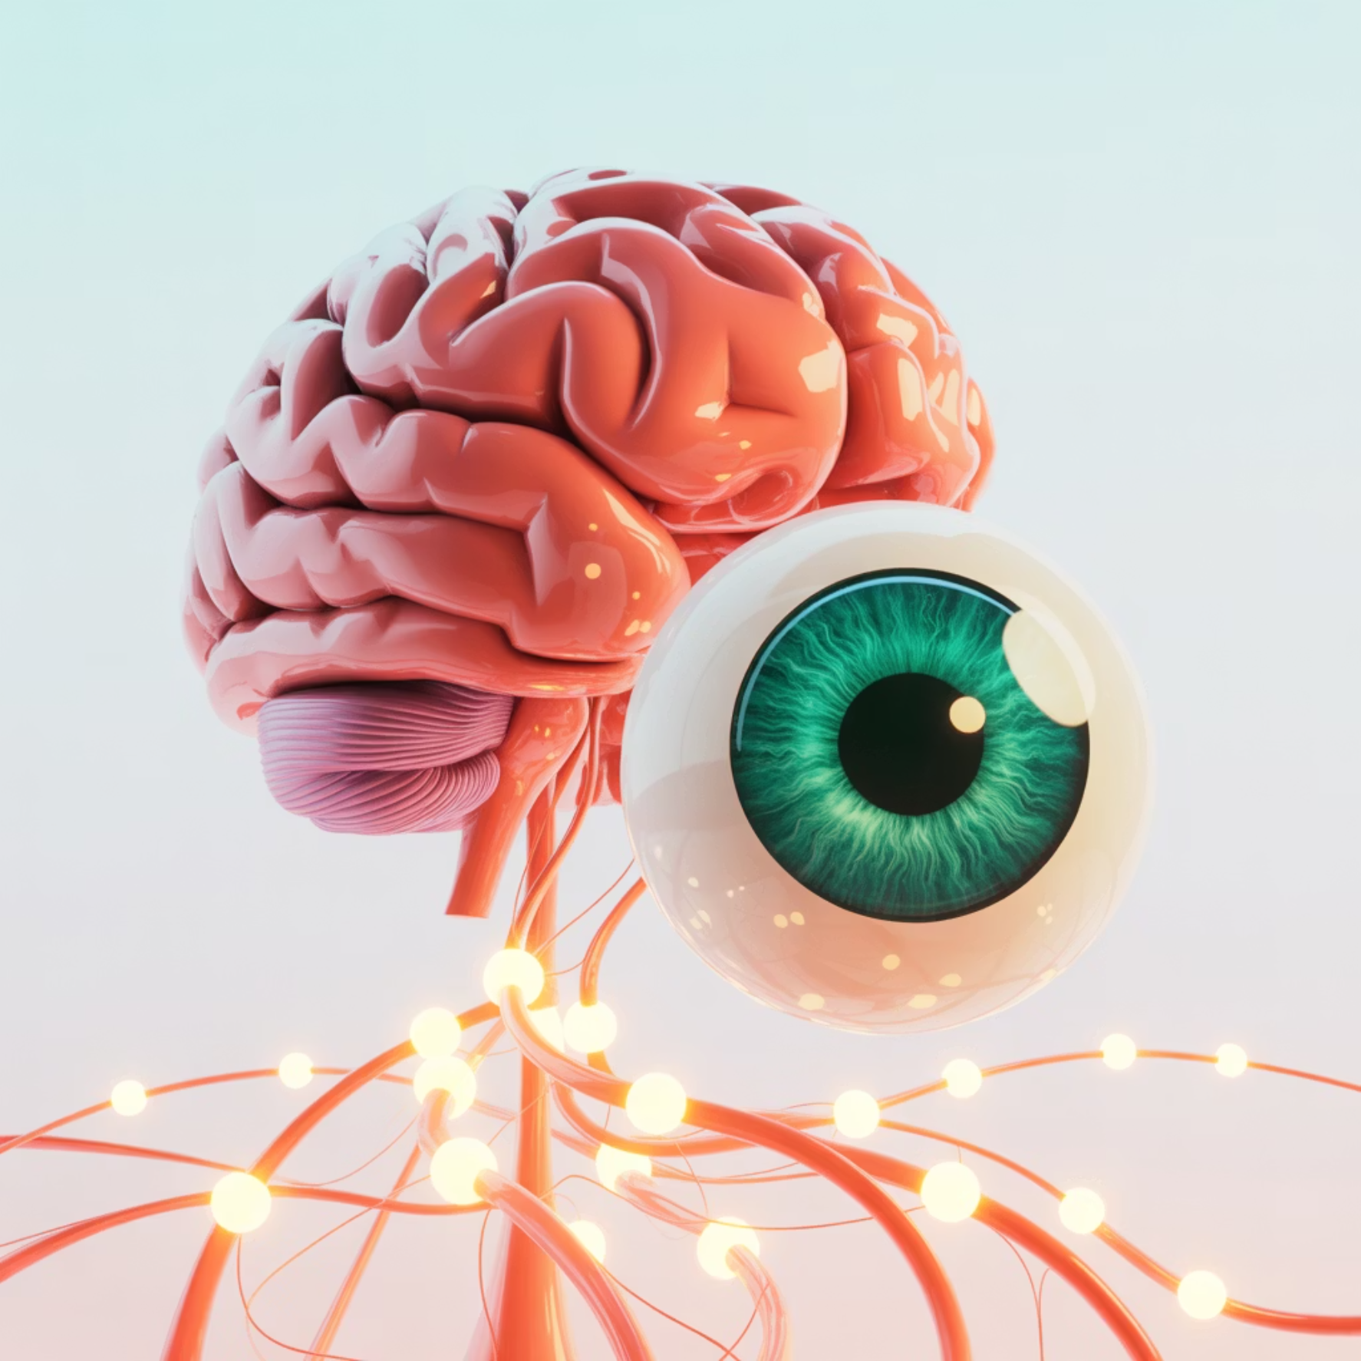
CNN - Like the Human Eye and Brain Working Together
Human Vision Analogy:
Your eye doesn't see everything at once—it focuses on small areas
Brain builds understanding gradually: edges → shapes → objects → meaning
Example: Looking at a face—first see edges, then nose/eyes, then recognize person
CNN Works Similarly:
Local focus: Each "digital eye" (filter) looks at small image patches
Hierarchical building: Simple features combine into complex ones
Pattern recognition: Learns to identify objects like humans do
CNNs mimic our visual processing system, building understanding from simple features to complex objects.
Real-World CNN Applications You Use Daily:
Photo apps
Medical apps
Auto-tagging friends in pictures
Skin cancer detection from phone photos
Security
Accessibility
Facial recognition in airports
Automatic image descriptions for visually impaired

Slide 4

CNN Evolution - Like Camera Technology Advancement
Camera Evolution Analogy:
Film cameras (Traditional ML)
Manual settings, limited shots
Digital cameras (AlexNet 2012)
Automatic features, but basic
Smartphone cameras (Modern CNNs)
AI-powered, professional quality
The Breakthrough Era:
AlexNet (2012): Like first iPhone camera—revolutionary but basic. Made computer vision accessible to everyone.
VGGNet (2014): Like professional DSLR—more "lenses" (layers) for better quality. Could recognize hundreds of object types.
Just as cameras evolved from basic to sophisticated, CNN architectures have progressed dramatically in capability and performance.
ResNet (2015): Like modern AI camera—incredibly deep understanding. Better than human accuracy in many vision tasks.

Slide 5

Residual Networks - Like Memory Aids in Learning
Learning a Language Analogy:
Problem: Learning advanced concepts while forgetting basics
Example: Learning complex grammar but forgetting simple words
Solution: Keep referring back to fundamentals while learning advanced topics
ResNet's Skip Connections:
Like keeping a cheat sheet of basics while learning advanced concepts
Mathematical representation: Output = Basic_knowledge + New_learning
In practice: Output = x + F(x)
ResNets solve the "forgetting problem" in deep networks, similar to how reference materials help us learn complex topics without forgetting the basics.
Real-World Examples:
Medical diagnosis
Financial analysis
Language translation
Basic symptoms + Complex pattern recognition
Fundamental indicators + Advanced market patterns
Word meanings + Context understanding
Why It Works: Never lose fundamental information while gaining complexity

Slide 6
CNN Architectures - Like Different Types of Experts
Just as we consult different medical specialists depending on our needs, we choose different CNN architectures based on our specific task requirements.
Architecture
Like a
Specialty
Real-World Use
AlexNet
General Practitioner
Basic diagnosis
Simple image recognition
VGG
Specialist Doctor
Detailed analysis
Quality image classification
Inception
Efficiency Expert
Smart resource use
Mobile phone apps
ResNet
Senior Consultant
Deep expertise
Medical imaging, autonomous cars
Choosing the Right Expert:
Simple task: Use AlexNet (like seeing a GP for common cold)
Complex task: Use ResNet (like seeing a specialist for rare disease)
Resource limited: Use MobileNet (like telemedicine consultation)
Performance Trend: Like medical expertise—more experience (layers) = better diagnosis (accuracy)

Slide 7


Convolution - Like Using a Magnifying Glass
Magnifying Glass Analogy:
You scan a document slowly, moving magnifying glass across text
Focus on small areas—can only see few words at a time
Look for specific things—maybe searching for phone numbers or dates
Build complete understanding—combine local observations
Mathematical Definition:
Real-Life Examples:
Quality inspector: Examining products with specialized tools
Radiologist: Scanning X-rays section by section
Proofreader: Checking document with specific grammar rules in mind
Security guard: Monitoring CCTV with focus on suspicious activities
The convolution operation is fundamental to CNNs—it allows the network to examine small parts of an image in detail, similar to how we might use a magnifying glass to inspect something closely.
Key Insight: Small, focused observations combine to create complete understanding

Slide 8
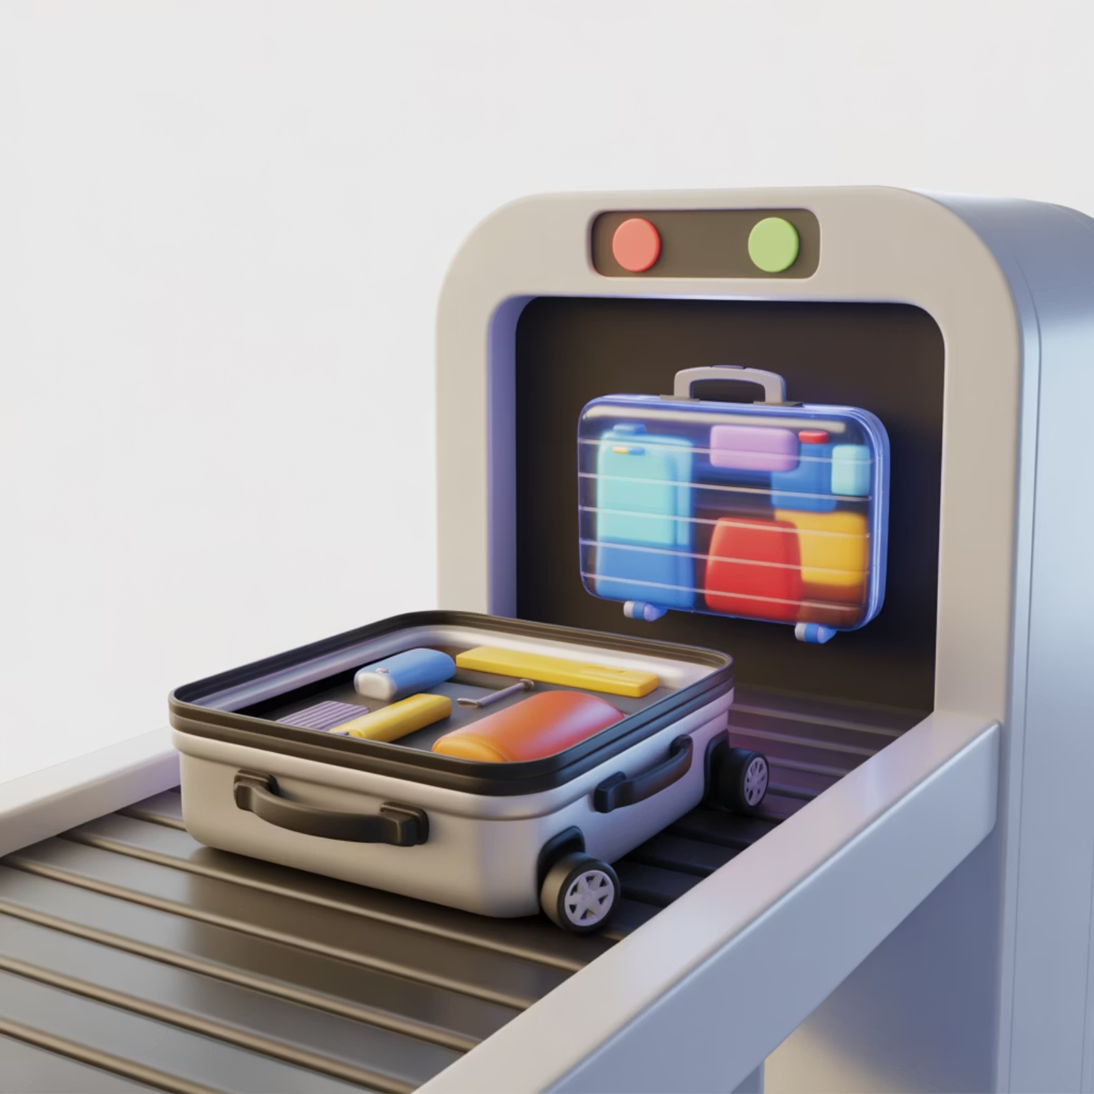
Feature Detection - Like Having Specialized Inspectors
Airport Security Analogy:
Different X-ray operators look for different things:
Weapons detector: Looks for metal objects and sharp edges
Liquid detector: Looks for containers and fluid patterns
Electronics detector: Looks for wires and circuit patterns
CNN Filter Examples:
Edge detector: Like looking for object boundaries in photos
Texture detector: Like feeling fabric to identify material type
Color detector: Like sorting fruits by ripeness
CNN filters work like specialized security inspectors, each trained to detect specific patterns or features in the input data.
CNN Structure - Like a Factory Assembly Line
Raw materials enter (input image)
Specialized stations (conv layers) each add specific features
Quality control checkpoints (pooling) remove defects and reduce size
Final inspection (fully connected) determines final product classification
This assembly line approach makes CNNs both efficient and effective at visual recognition tasks.

Slide 9
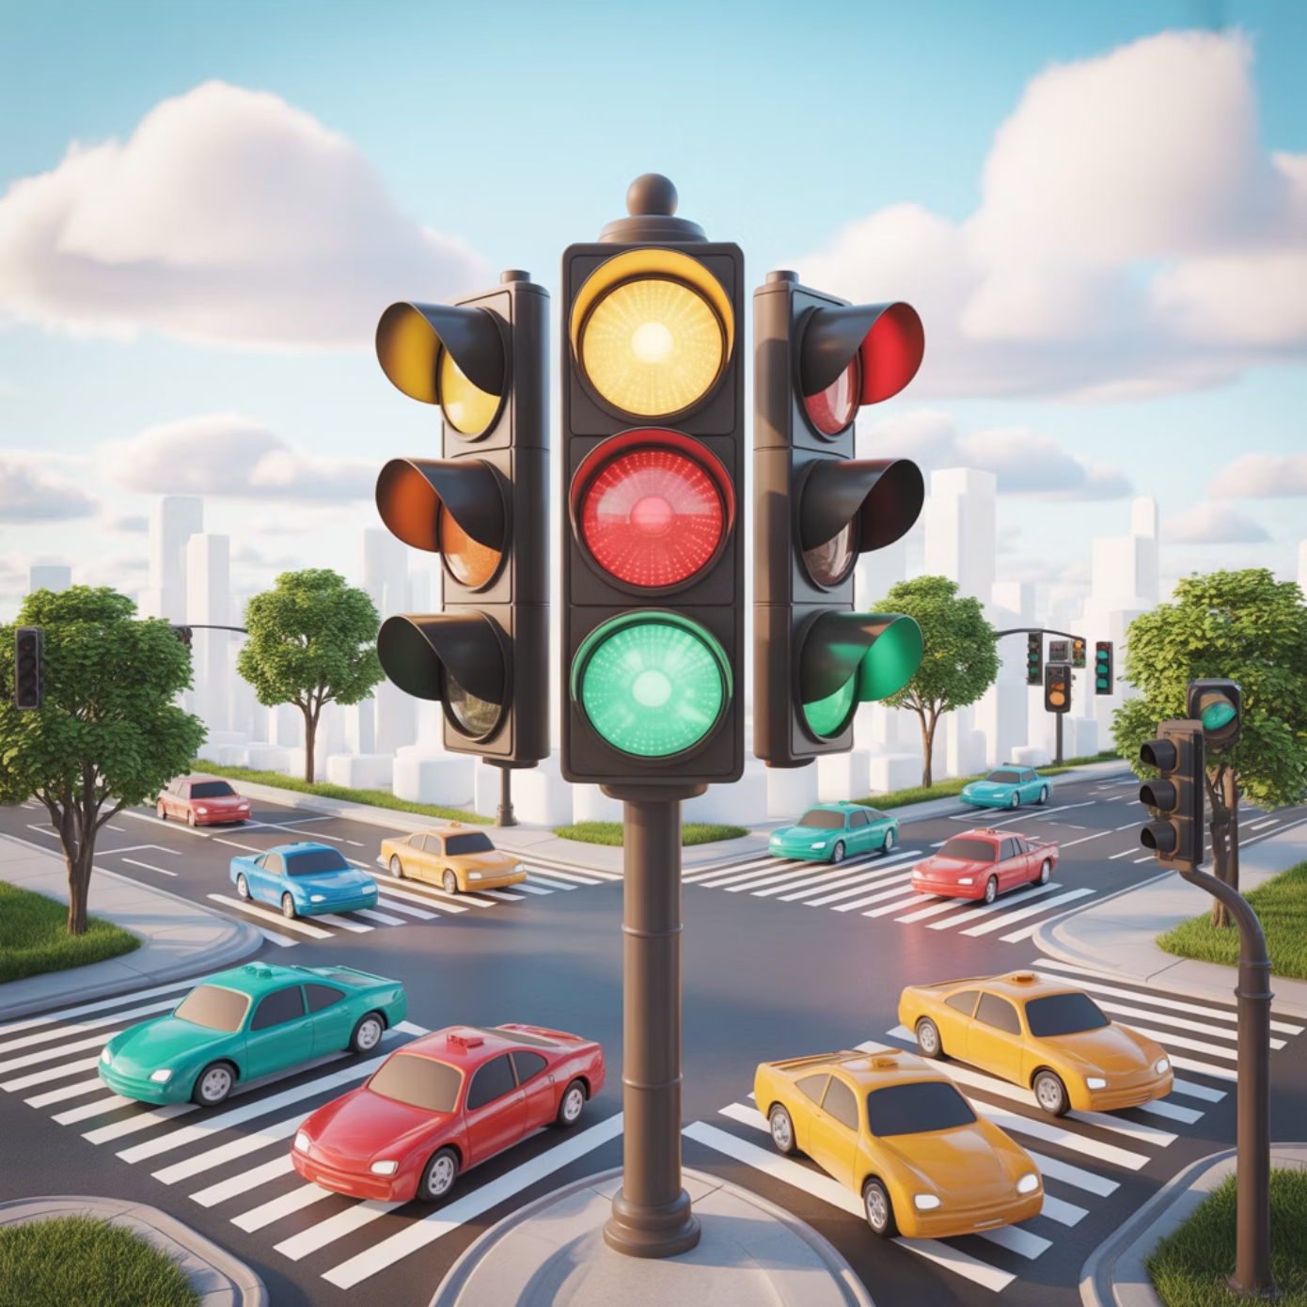



Activation Functions - Like Decision Gates in Daily Life
Traffic Light Analogy:
Without activation: Cars always move at same speed regardless of conditions
With activation: Traffic lights make binary decisions (stop/go) based on conditions
Result: Complex traffic flow patterns emerge from simple rules
Real-Life Decision Examples:
Thermostat: Temperature input → Heat on/off decision
ATM machine: PIN input → Access granted/denied
Smartphone: Touch pressure → Register tap or ignore
Activation functions introduce non-linearity into neural networks, enabling them to learn complex patterns that would be impossible with linear functions alone.
Why Non-linearity Matters:
Linear thinking: "If A, then always B"
Non-linear thinking: "If A and C, then maybe B, but if A and D, then definitely not B"
Common Activation Types:
Sigmoid: Like dimmer switch (smooth 0 to 1)
ReLU: Like on/off switch (0 or full value)
Tanh: Like car accelerator/brake (-1 to +1)

Slide 10
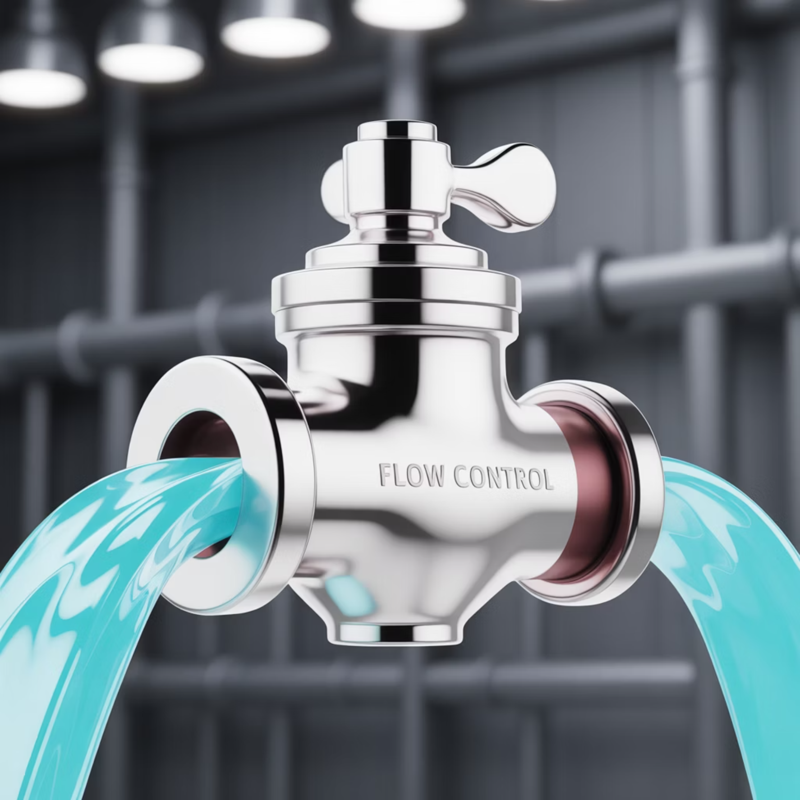
ReLU - Like a One-Way Valve
Water Valve Analogy:
Positive pressure: Water flows freely (value passes through)
Negative pressure: Valve blocks flow (output = 0)
Simple mechanism: Either on or off, no complex controls needed
Mathematical Definition:
Like: "If water pressure > 0, let it flow; otherwise, block completely"
Everyday Examples:
Automatic doors: Only open when someone approaches (positive signal)
Motion sensors: Only trigger lights when movement detected
Bank withdrawals: Only allow if sufficient balance (positive)
ReLU (Rectified Linear Unit) functions like a one-way valve in a water pipe, allowing positive values to flow through unchanged while completely blocking negative values.
Why ReLU Revolutionized Deep Learning:
Fast decisions
Clear signals
No complex calculations needed
Strong positive signals stay strong
Efficient
Reliable
Many neurons "turn off" saving computation
Doesn't get "confused" like older activation functions

Slide 11

Activation Functions - Like Different Types of Switches
Sigmoid: Dimmer Switch
Tanh: Car Accelerator/Brake
Swish: Smart Thermostat
Range: [-1, 1]
Like: Push forward to accelerate, pull back to brake
Like: Considers both temperature AND time of day for decisions
Like: Gradually brighten/dim lights (smooth 0 to 1)
Use case: Bidirectional control systems
Use case: Complex decision-making systems
Use case: Bedroom lighting, probability outputs
Real example: Steering wheel (left/right), volume control (up/down)
Real example: Smart home systems that learn your preferences
Real example: "How confident are you?" (0% to 100%)
Different activation functions serve specific purposes in neural networks, just as different types of switches and controls serve different purposes in our homes. The choice of activation function can significantly impact network performance and training dynamics.

Slide 12

Pooling - Like Reading a Newspaper Summary
News Summary Analogy:
Original article
1000 words with detailed information
Summary
100 words capturing main points
Headlines
10 words with key message
Goal: Keep important information, reduce complexity
Max Pooling Process:
Like highlighting important parts of a document
Example: Reading reviews and noting only the highest ratings
Result: "This restaurant has excellent food" (keeping the best signal)
Pooling layers in CNNs reduce spatial dimensions while preserving the most important information, similar to how a good summary captures the essence of a longer text.
Real-World Pooling Examples:
Sports highlights
Movie trailers
3-hour game → 5-minute highlight reel
2-hour movie → 2-minute trailer
Meeting minutes
Social media
1-hour discussion → key decisions summary
Thousands of posts → trending topics

Slide 13
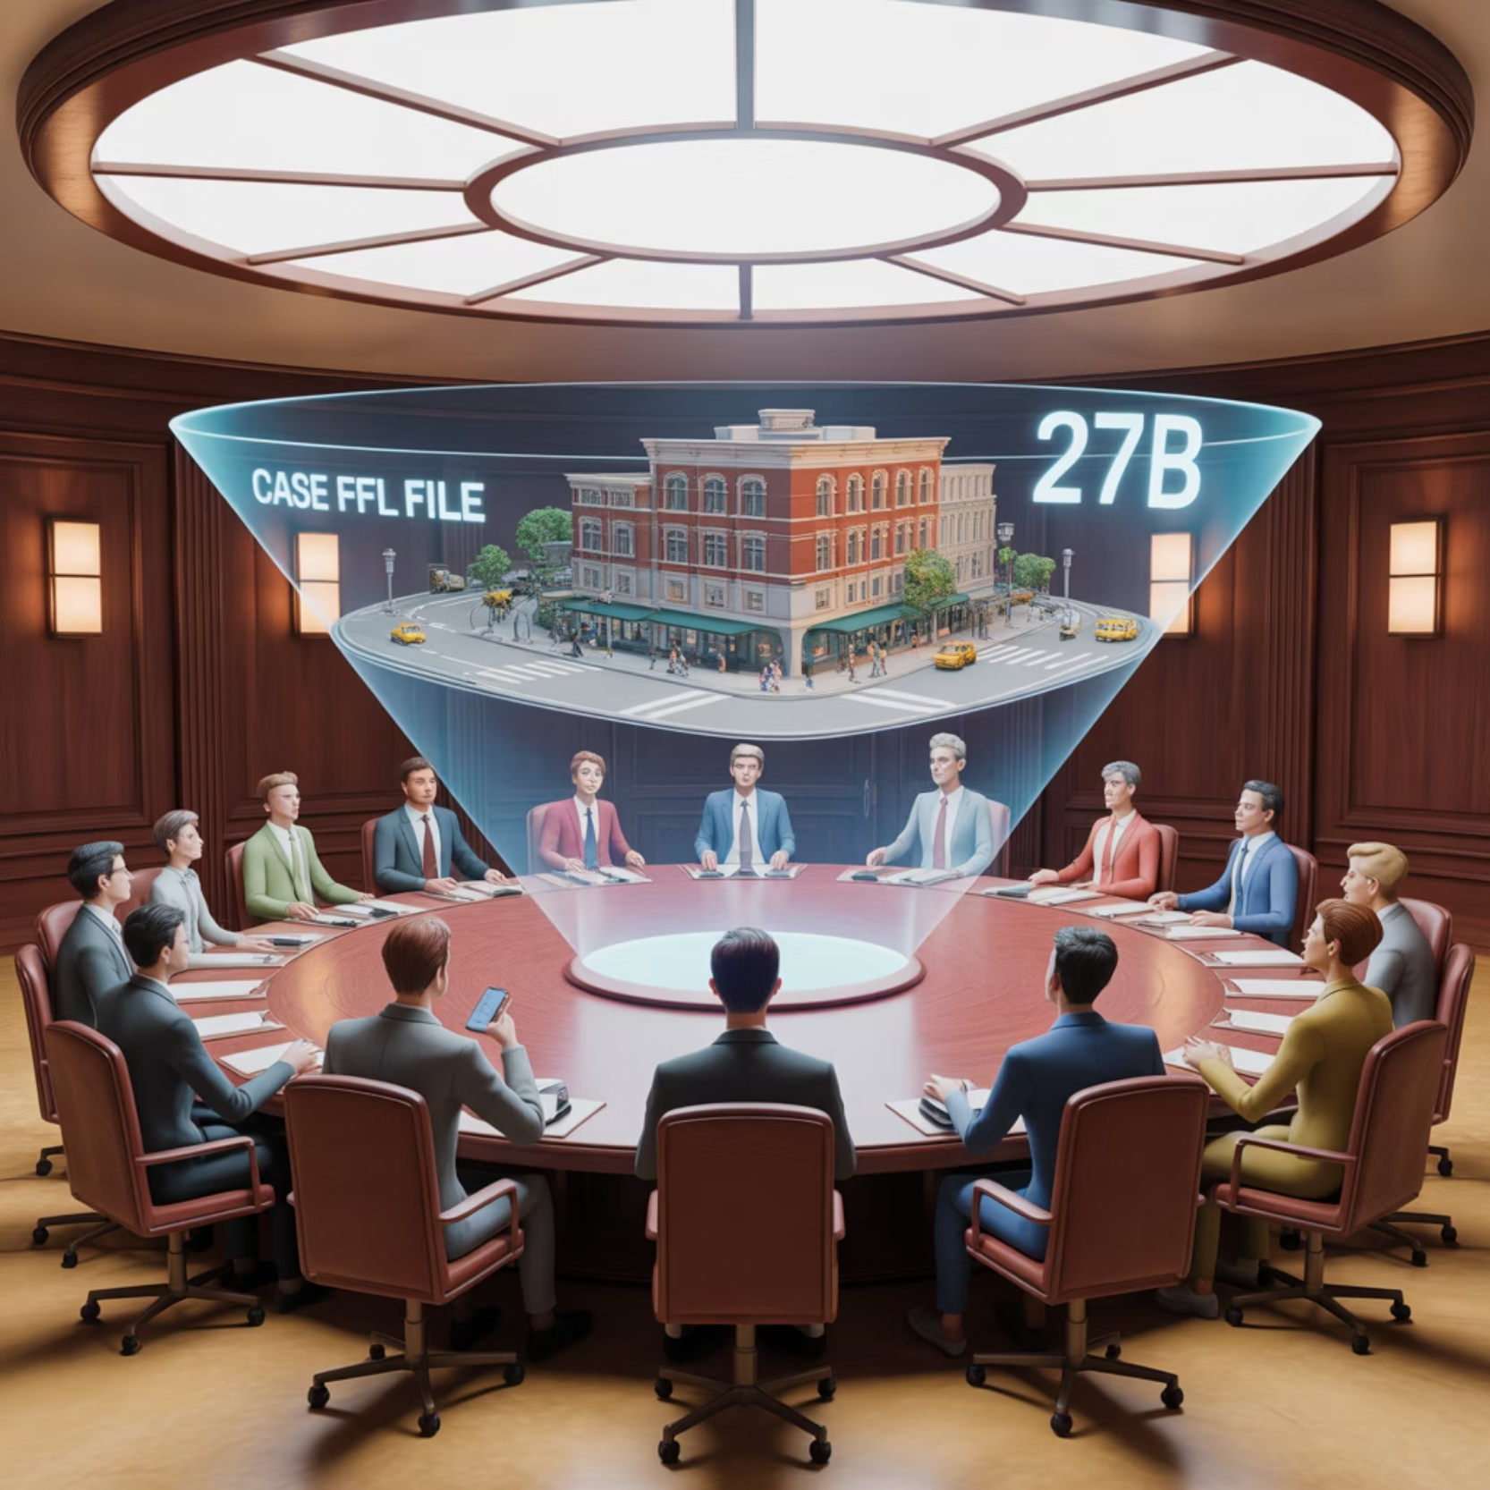




From Evidence to Verdict - Like a Jury System
Courtroom Analogy:
Evidence gathering
Convolutional layers collect facts
Jury deliberation
Fully connected layers weigh all evidence
Final verdict
Softmax provides final classification decision
How Jury (Fully Connected Layer) Works:
Each juror considers ALL evidence (every neuron connects to all features)
Jurors discuss and influence each other (weighted connections)
Final vote reflects combined judgment (class probability)
Fully connected layers in a CNN function like a jury in a courtroom, considering all the evidence collected by the convolutional layers before reaching a final decision.
Real-World Decision Examples:
Medical diagnosis
Loan approval
Symptoms + tests + history → diagnosis
Income + credit + history → approve/deny
Job hiring
Restaurant recommendation
Skills + experience + interview → hire/reject
Taste + location + price + reviews → rating

Slide 14





Dropout - Like Studying Without Your Best Friend
Study Group Analogy:
Problem: Always studying with the same smart friend
Risk: Become too dependent, can't think independently
Solution: Sometimes study alone or with different people
Result: Become more well-rounded and self-reliant
Dropout in Neural Networks:
Randomly "remove" some neurons during training
Forces network to not rely on specific neurons
Like learning to solve problems multiple ways
Dropout prevents overfitting by forcing the network to develop redundant pathways for solving problems, similar to how studying independently builds self-reliance.
Real-Life Examples:
Sports team: Practice with different player combinations
Work team: Cross-train employees so no single person is indispensable
Emergency planning: Have backup systems when primary ones fail
Learning skills: Practice piano sometimes without sheet music
Benefits: Robustness, Generalization, Prevention of overfitting

Slide 15
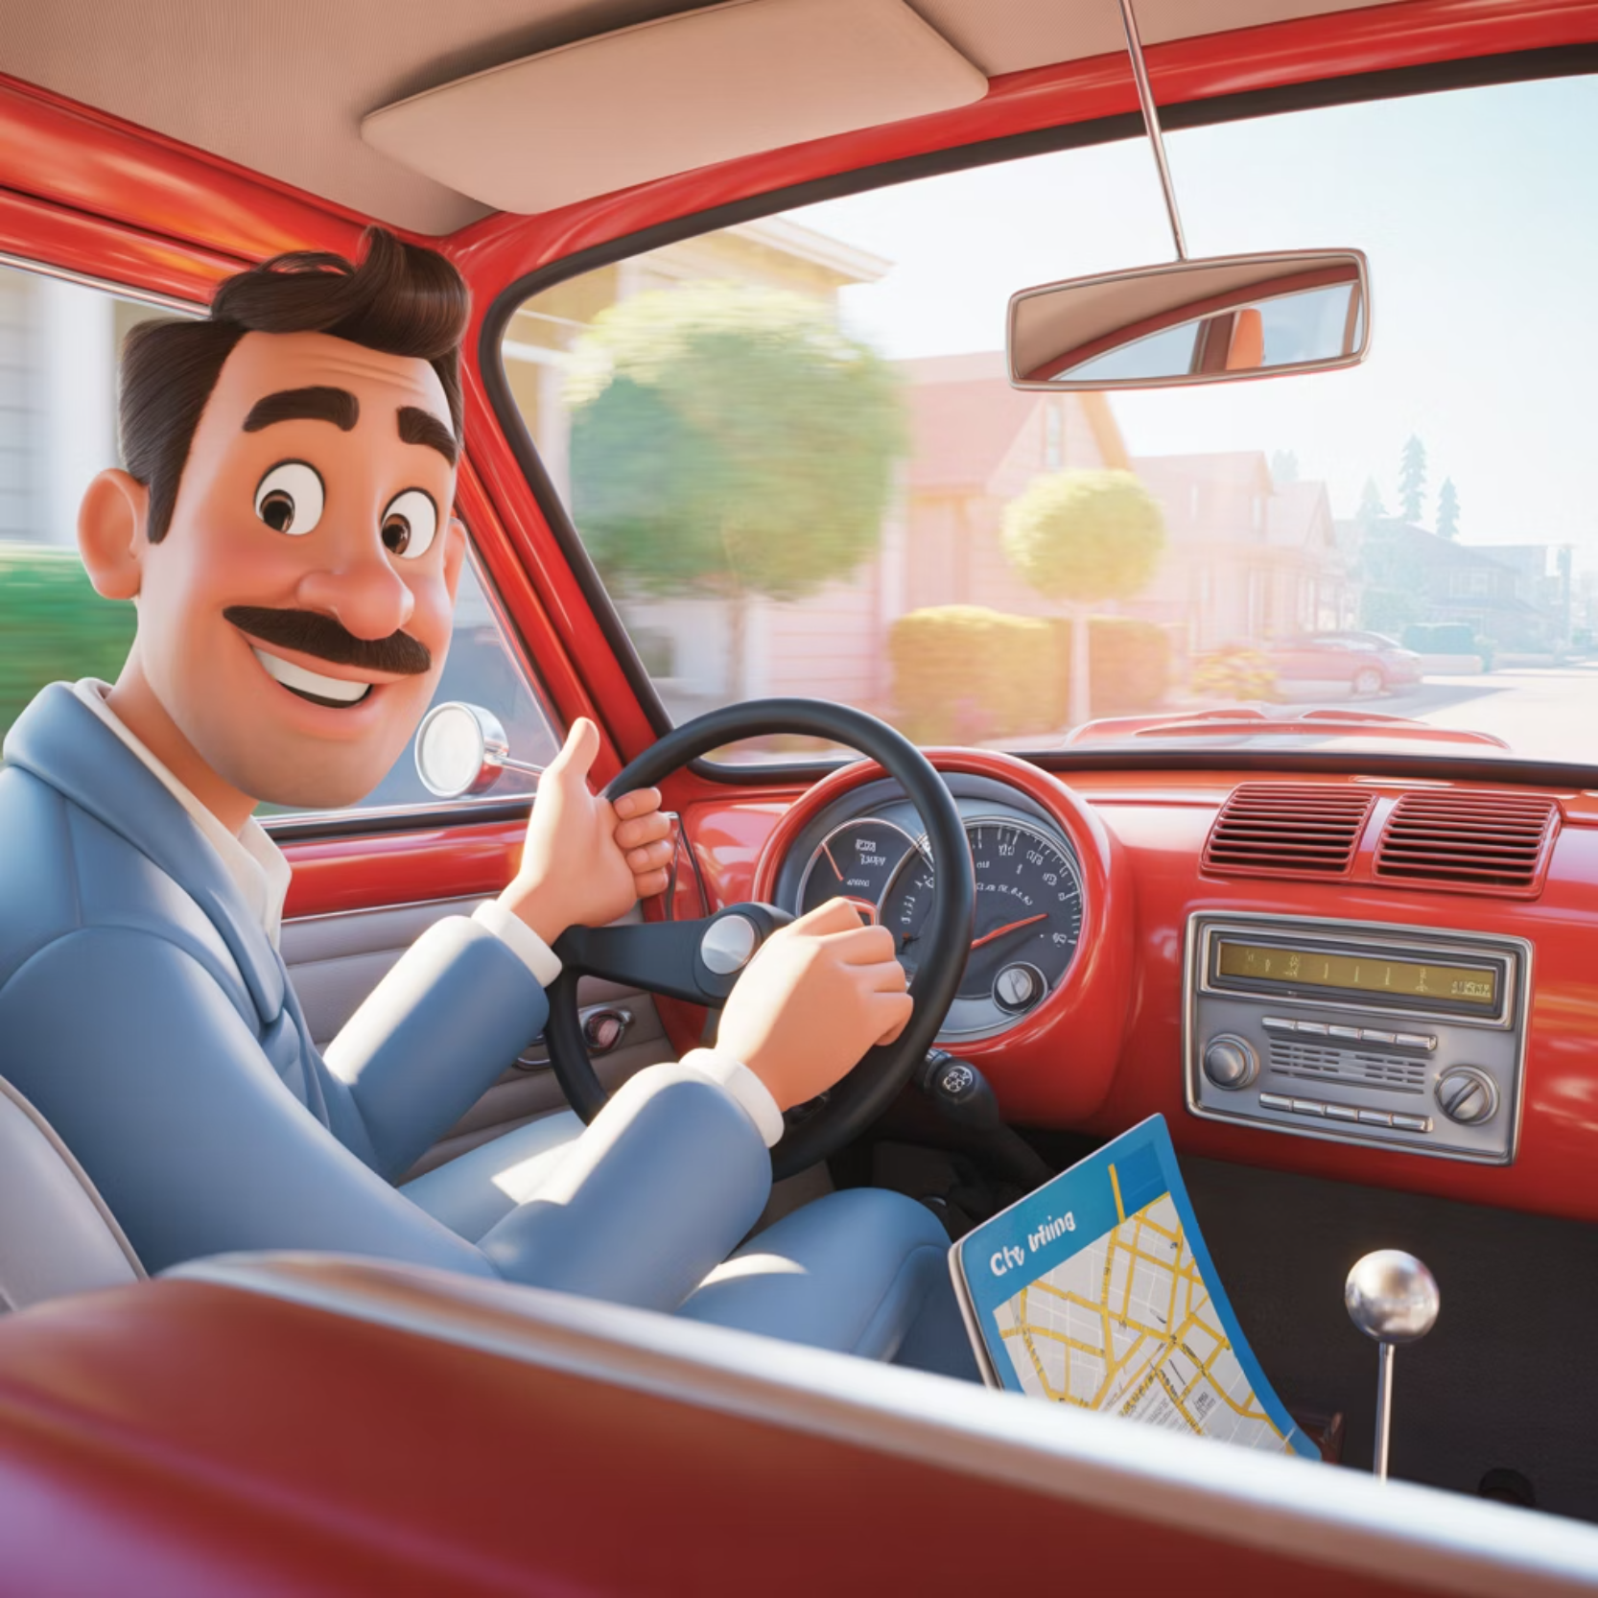








CNN Learning - Like Learning to Drive
Forward Pass (Observing):
See the road (input image)
Notice details (convolution): traffic lights, signs, cars
Process information (activation): "That's a red light"
Summarize situation (pooling): "Need to stop"
Make decision (fully connected): "Apply brakes"
Backward Pass (Learning from Mistakes):
Instructor feedback (loss calculation): "You stopped too late"
Understand what went wrong (backpropagation): "Didn't notice red light early enough"
Adjust behavior (weight update): "Look for traffic lights sooner"
Practice again (next iteration): Try another driving scenario
CNN training follows a similar process to learning to drive—observing, making decisions, receiving feedback, and gradually improving over time.
Key Insight: Like human learning, networks improve through:
Experience
Feedback
Seeing many examples
Knowing when mistakes are made
Practice
Adjustment
Repeating until mastery
Changing behavior based on feedback

Slide 16
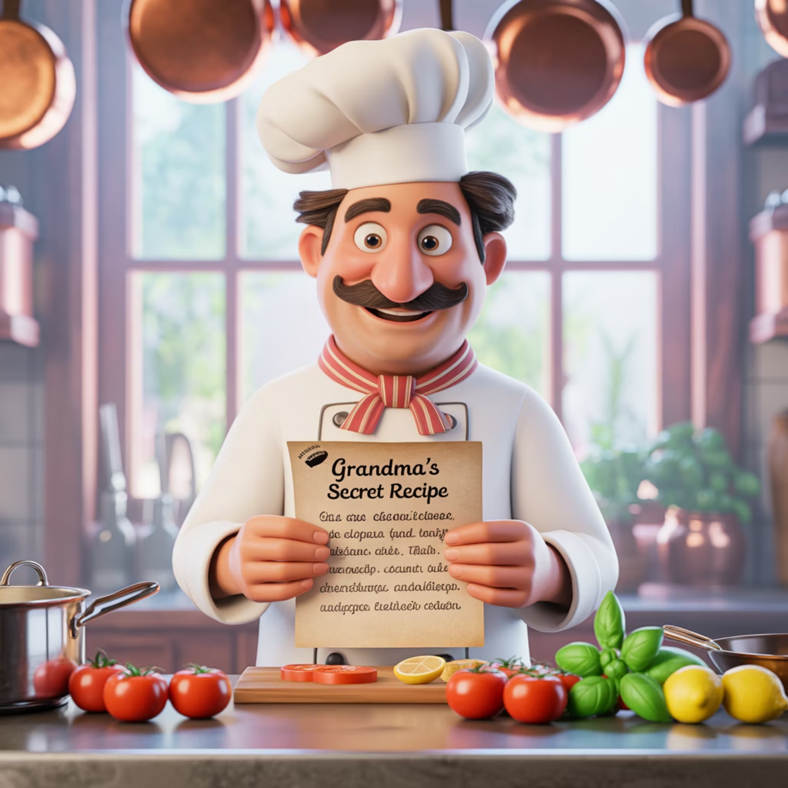
CNN Hyperparameters - Like Recipe Adjustments
Cooking Recipe Analogy:
Recipe ingredients = architecture parameters
Cooking technique = training parameters
Taste testing = validation and tuning
Architecture "Ingredients":
Number of layers: Like cooking stages (prep → cook → garnish)
Filter size: Like knife size (fine dicing vs rough chopping)
Number of filters: Like number of spices (more variety = more complex flavors)
Hyperparameters in CNNs are like recipe adjustments in cooking—small changes can dramatically affect the final result.
Training "Technique":
Learning rate
Batch size
Dropout
Like cooking temperature (too high burns, too low takes forever)
Like cooking portions (individual plates vs family size)
Like varying ingredients to prevent predictable taste
Real Cooking Examples:
Beginner cook: Follow proven recipes exactly (use standard architectures)
Experienced chef: Adjust based on available ingredients (tune for your data)
Master chef: Create new combinations (novel architectures)

Slide 17
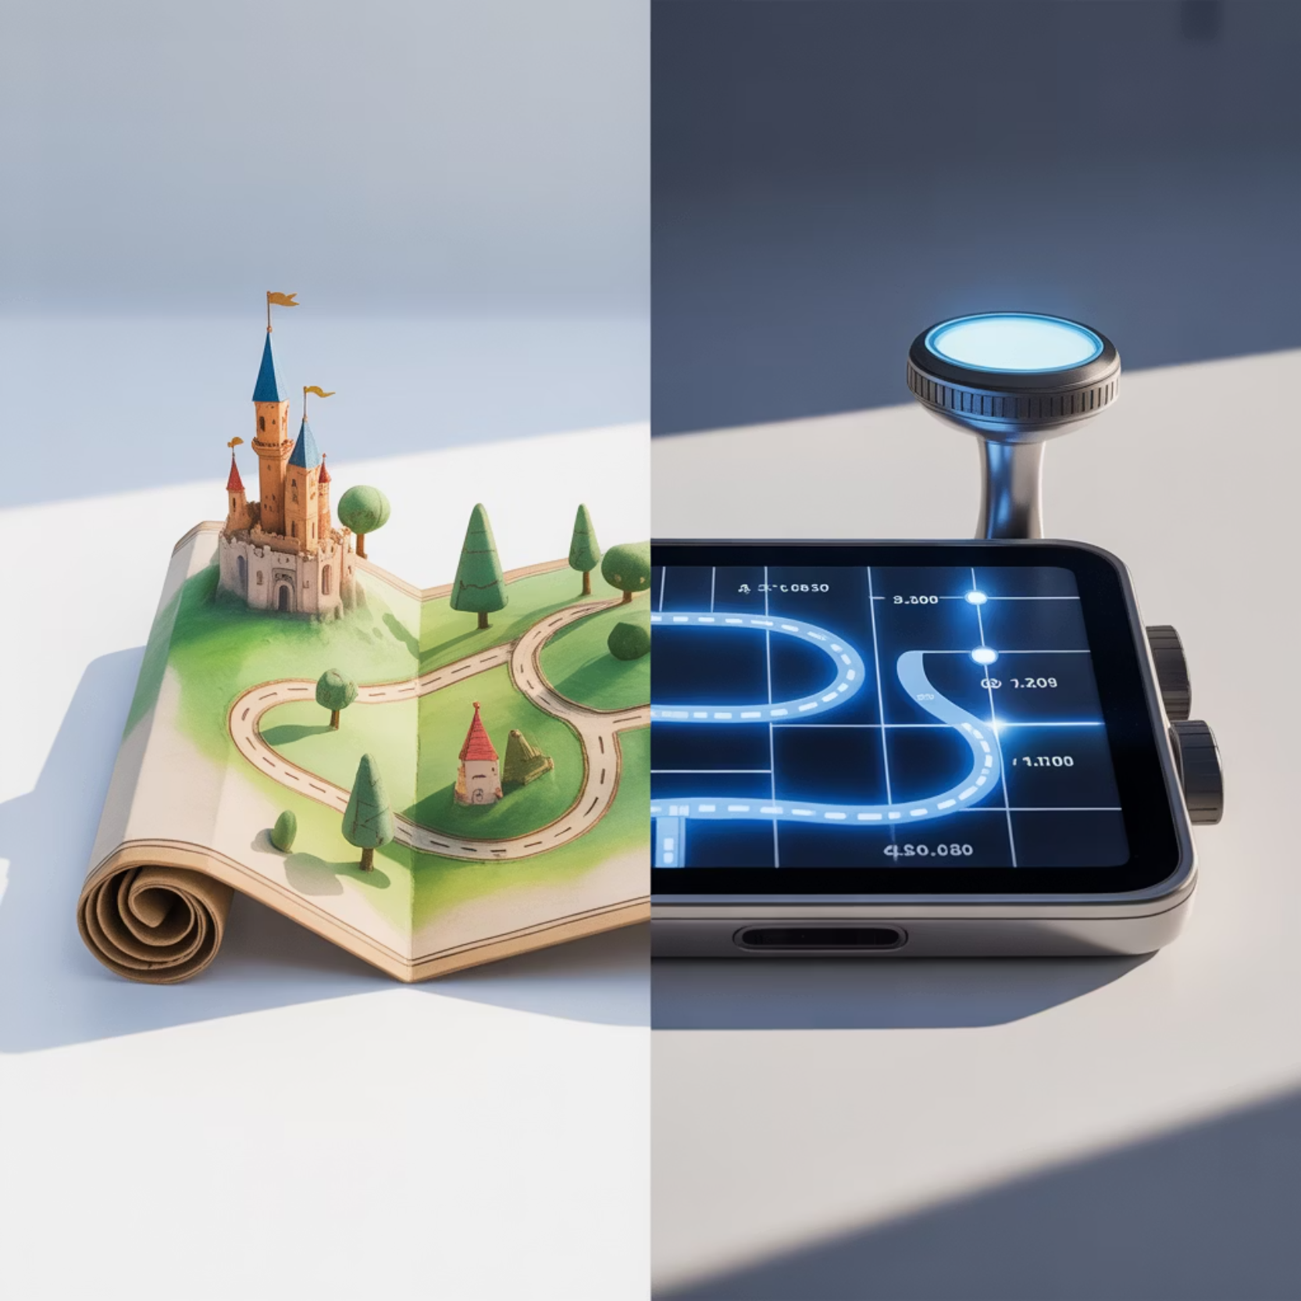




CNN vs Traditional Methods - Like GPS vs Paper Maps
Paper Maps (Traditional Computer Vision):
Manual route planning: Expert knowledge required
Fixed routes: Same path every time
Limited information: Only roads, no traffic
Expertise needed: Must understand map symbols
GPS Navigation (CNNs):
Automatic route finding: AI figures out best path
Adaptive routing: Adjusts based on real-time conditions
Rich information: Traffic, accidents, construction
User-friendly: Just enter destination
CNNs represent a paradigm shift in computer vision, similar to how GPS navigation revolutionized how we find our way compared to paper maps.
Real-World Impact Examples:
Medical imaging
Photo organization
Radiologist + AI vs radiologist alone
Auto-tagging vs manual sorting
Security systems
Quality control
Smart cameras vs human monitoring
AI inspection vs human inspection
The revolution: From needing experts to AI doing expert-level work automatically

Slide 18

CNNs in Your Daily Life - You Use Them More Than You Think
Morning to Night CNN Usage:
Morning
Commute/Work
Evening
Unlock phone: Face recognition (CNN)
Navigation apps: Traffic analysis from satellite images
Shopping: Visual search ("find similar items")
Check photos: Auto-organized albums (CNN)
Public transport: Crowd estimation from camera feeds
Social media: Auto-tagging friends, content moderation
Read news: Article recommendations (CNN for image analysis)
Email: Spam detection with image analysis
Streaming: Content recommendations based on thumbnails
Video calls: Background blur and virtual backgrounds
Document scanning: Text recognition from phone camera
Healthcare Impact:
Skin cancer detection
Eye exams
Phone apps as accurate as dermatologists
Diabetic retinopathy screening
X-ray analysis
Faster and more accurate diagnosis

Slide 19
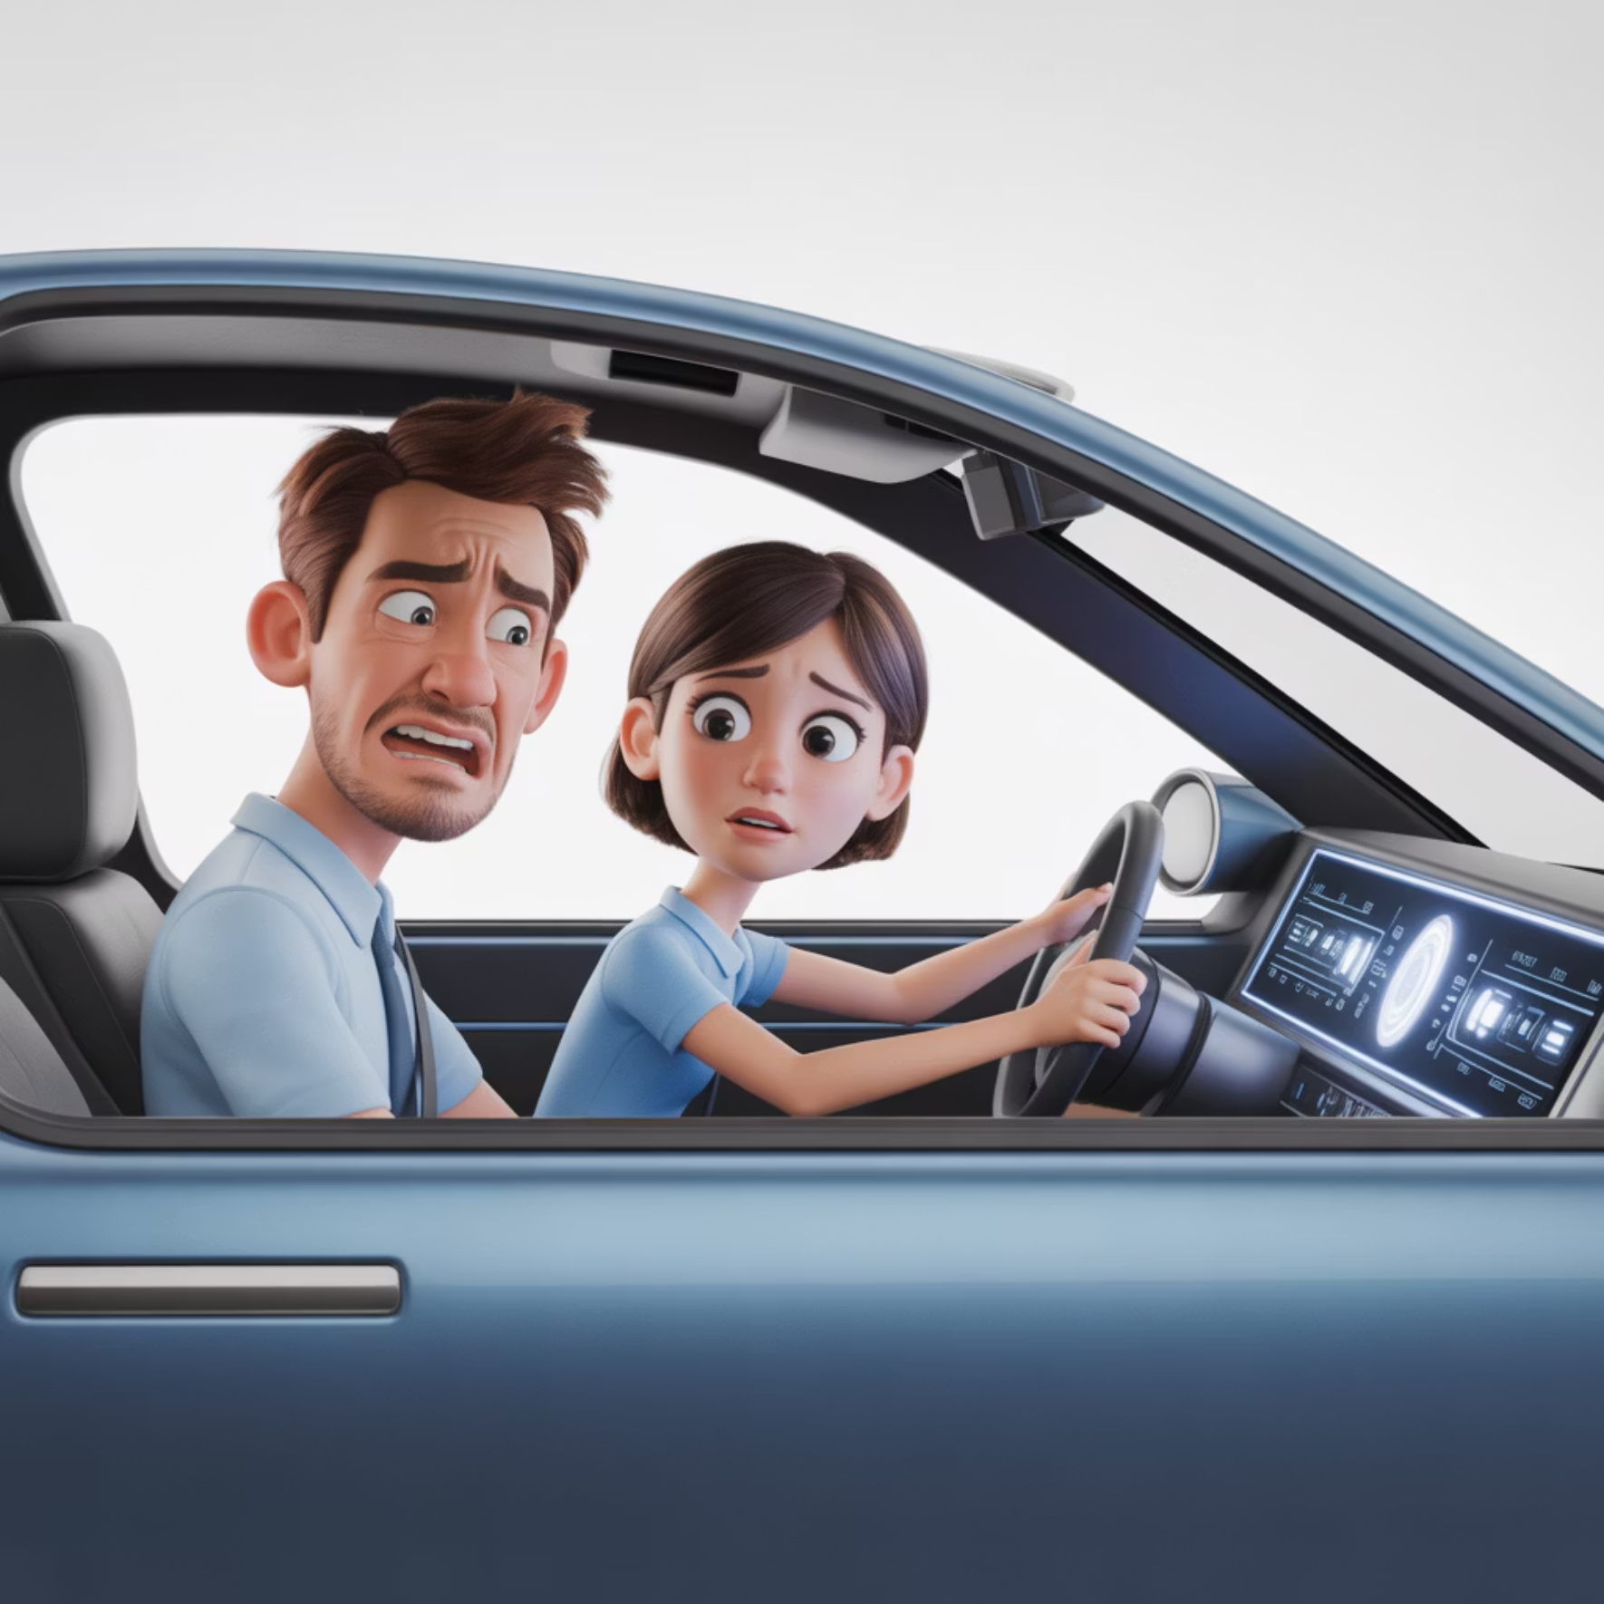
CNN Challenges - Like Teaching Someone to Drive
Data Requirements (Practice Hours):
Problem: Need thousands of hours of practice
Real world: CNNs need millions of labeled examples
Example: Teaching photo recognition requires millions of tagged photos
Computational Cost (Expensive Training):
Problem: Professional driving school is expensive
Real world: Training CNNs requires powerful computers
Example: Training GPT-3 cost millions of dollars
Despite their power, CNNs face significant challenges that mirror the difficulties in teaching complex skills like driving.
Other Critical Challenges:
Black Box Problem
Bias Issues
Problem: Student can drive but can't explain why they turned left
Problem: Learning to drive only in one city
Real world: CNN makes correct predictions but can't explain reasoning
Real world: AI trained on biased data makes biased decisions
Example: AI diagnoses cancer correctly but doctors don't know why
Example: Facial recognition works poorly for certain ethnic groups

Slide 20
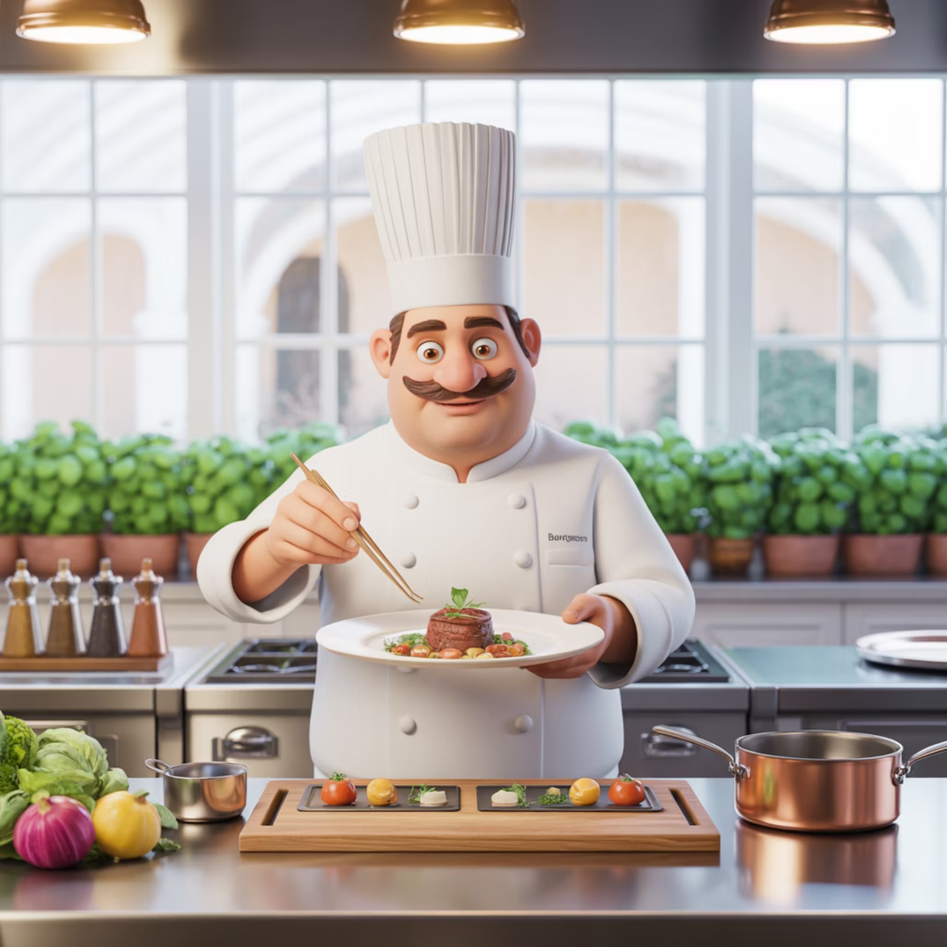



CNN Success Recipe - Like Running a Successful Restaurant
Quality Ingredients (Data Preparation):
Source fresh, diverse ingredients (high-quality, diverse training data)
Proper food storage (data augmentation and preprocessing)
Taste testing (train/validation/test splits)
Kitchen Setup (Architecture Design):
Use proven recipes first (start with ResNet, VGG)
Hire experienced chefs (transfer learning)
Start simple, add complexity gradually (avoid overfitting)
Building successful CNN applications requires careful planning and execution, similar to running a high-quality restaurant.
Cooking Process (Training Strategy):
Monitor temperature constantly (track training metrics)
Don't overcook (early stopping)
Season appropriately (regularization techniques)
Customer Service (Deployment):
Optimize for efficiency (model compression)
Test with real customers (A/B testing)
Keep improving based on feedback (continuous monitoring)
Success Metrics: Happy customers (high accuracy) who return (good generalization)

